Slide 1


J.B. INSTITUTE OF ENGINEERING & TECHNOLOGY
UGC Autonomous
Accredited by NAAC & NBA, Approved by AICTE & Permanently Affiliated to JNTUH
Smart Innovation Hackathon
Presentation on
Effective Management of Construction and Demolition (C&D) Waste in road construction
1

Slide 2
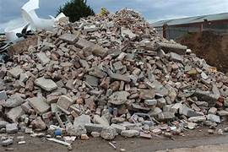
"Understanding Construction and Demolition Waste ( C&D )"
Construction and Demolition (C&D) waste refers to the materials generated during the construction, renovation, and demolition of buildings and infrastructure.
Waste building materials, dredging materials that are produced in the process of constructions, remodeling. repair, or demolition of residential buildings, commercial buildings and other structure and pavement.
It includes materials like concrete, wood, metal, bricks, and more.
India generates a significant amount of C&D waste annually.
2

Slide 3
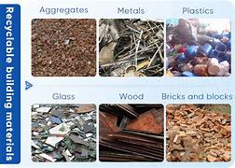
Construction and Demolition Waste consists of
Concrete
Bricks
Timber
Sanitary ware
Glasses
Steel
Plastic
3

Slide 4
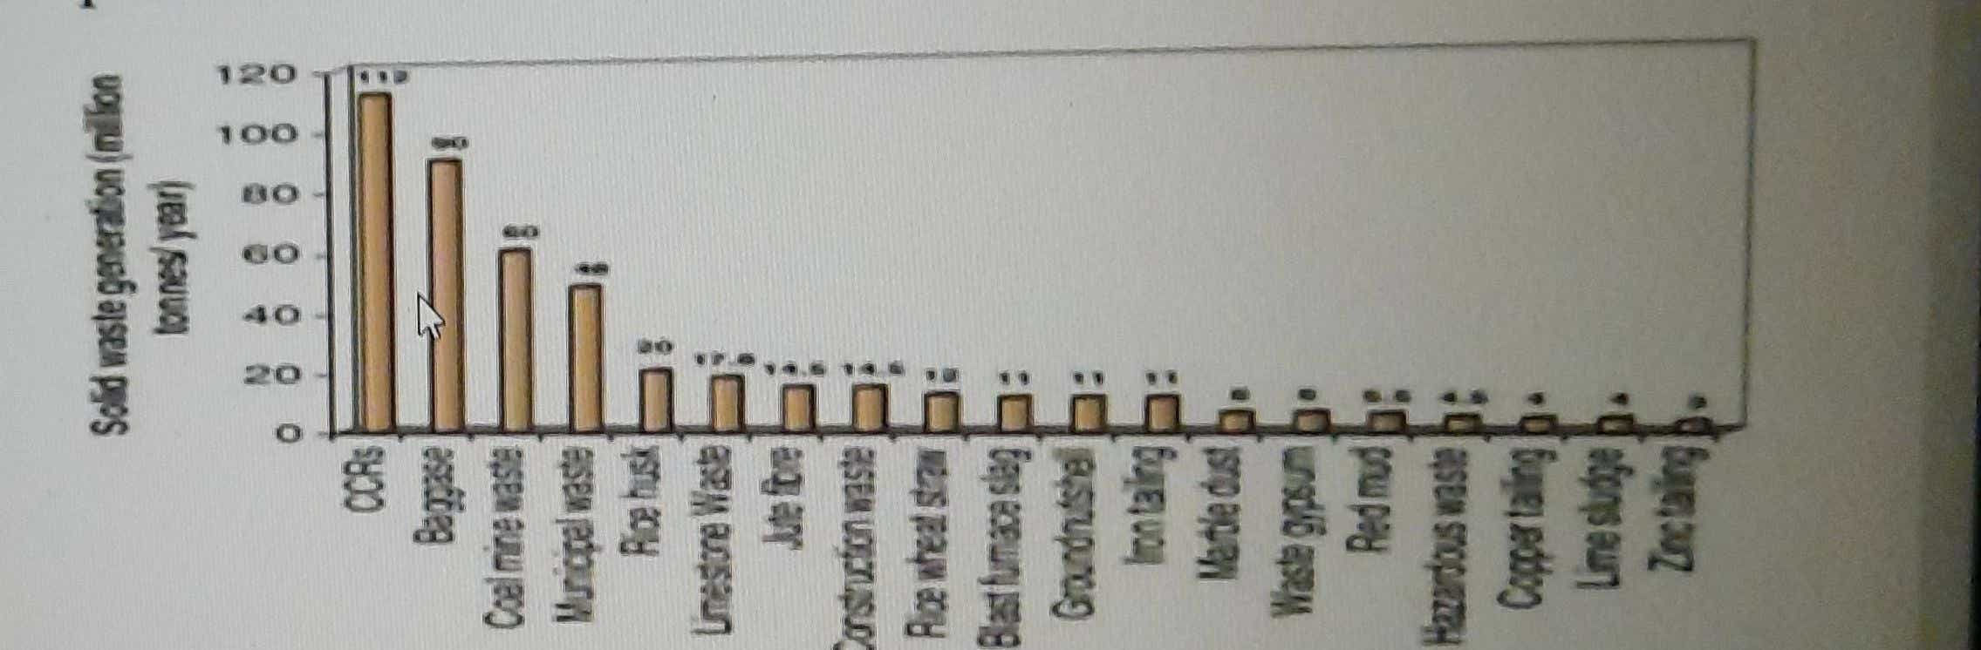
Present Situation Of Construction and Demolition Waste Generation in INDIA
It is Estimated that out of the waste produced annually in India is 48 MT of total solid waste and in that the C&D waste constitutes totally of 14.5 MT.
4

Slide 5
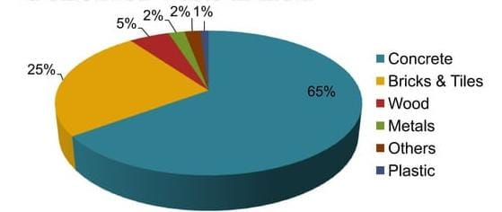
Total Composition of construction and demolition waste
5

Slide 6
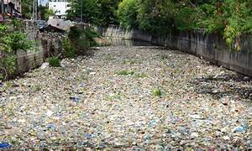
WHY?
Rapid urban development and construction projects lead to increased waste generation.
Expanding infrastructure, such as roads and bridges, generates substantial C&D waste
Inadequate recycling practices in the construction industry add to waste volumes.
Lack of awareness about C&D waste management leads to improper disposal.
6

Slide 7
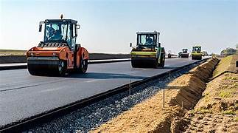
Main Issue For Construction & Demolition Waste
Rapid Urbanization
Shorter Building Lifespan
Inefficient Waste Separation
Limited Recycling and Reuse
Illegal Dumping
7

Slide 8
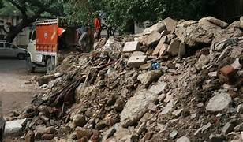
The Impact Of C&D Waste
Environmental Impact
C&D waste often ends up in landfills, contributing to soil and water pollution.
Health Concerns
Exposure to C&D waste components can pose health risks, including respiratory problems.
Resource Depletion
Valuable resources like wood and metals are wasted when C&D materials are not managed effectively.
Economic Implications
Poor C&D waste management leads to economic losses and missed opportunities for recycling and reusing materials.
Sustainability Challenge
Effectively managing C&D waste is crucial for sustainable urban development.
8

Slide 9
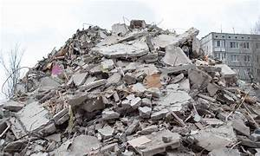
Challenges in C & D Waste Management
Lack of proper recycling and disposal facilities for C&D waste hinders effective management.
C&D waste often contains mixed materials, making sorting and recycling more complex.
Transporting bulky C&D waste materials to recycling centers can be logistically challenging
Recycling C&D waste can be expensive, deterring some from investing in sustainable practices.
Illegally dumped C&D waste creates environmental hazards and complicates waste management efforts.
Many construction professionals and the public are unaware of proper C&D waste management practices.
Recovering valuable resources like metals and wood from C&D waste requires specialized processes.
9

Slide 10
IMPORTANCE OF CONSTRUCTION & DEMOLITION WASTE MANGEMENT
Proper C&D waste management reduces the strain on natural resources by promoting recycling and reusing materials.
It mitigates environmental pollution, preventing soil and water contamination caused by improper disposal.
Recycling and reusing C&D waste materials can generate economic benefits by reducing disposal costs and creating jobs in the recycling industry.
It encourages a circular economy, where materials are reused and retained in the economic cycle.
Complying with C&D waste management regulations ensures legal adherence and minimizes the risk of fines or penalties.
10

Slide 11

SUSTAINABLE SOLUTIONS FOR C&D MANAGEMENT
Waste Segregation at Source
Encourage construction sites to segregate waste at the source, separating materials like concrete, wood, and metal for recycling and reuse.
Material Recovery Facilities (MRFs)
Establish Material Recovery Facilities where C&D waste can be sorted and valuable materials recovered for recycling.
Promote Reuse
Encourage the reuse of materials like bricks and fixtures from demolished buildings in new construction projects to reduce waste generation.
Recycling Initiatives
Support recycling initiatives that process C&D waste into new construction materials, such as recycled aggregates for concrete.
Public Awareness and Education
Educate construction professionals, homeowners, and the public about the benefits of sustainable C&D waste management and how to practice it
11

Slide 12

"Revolutionizing Road Construction: Sustainable Solutions for Effective C&D Waste Management"
12

Slide 13
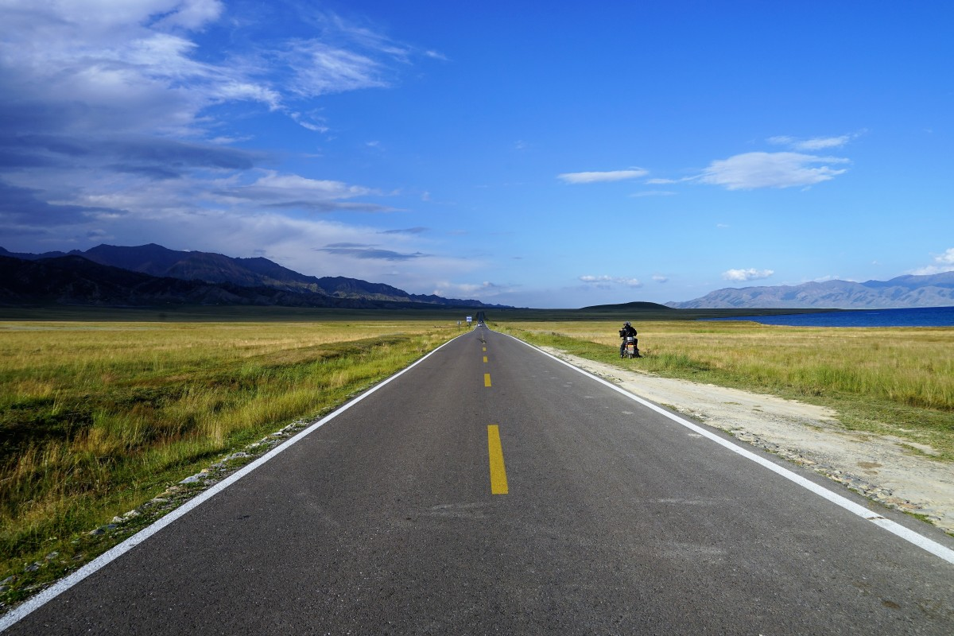
What is Road?
Roads are the fundamental infrastructure for land-based transportation.
They provide essential connectivity for communities, industries, and commerce.
Roads play a pivotal role in enabling the movement of people and goods.
A well-developed road network contributes to economic growth and development.
13

Slide 14
OBJECTIVES
Develop a conceptual framework for a sustainable C&D waste management system tailored to road construction projects.
Create a functional prototype design that showcases the key components and processes of the proposed system.
Evaluate the prototype's performance in terms of waste reduction, resource recovery, and environmental impact compared to traditional methods.
14

Slide 15
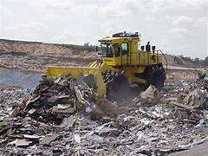
Problem of Excessive Waste in Construction
Construction and demolition (C&D) activities generate massive amounts of waste, including concrete, bricks, wood, and metals.
Much of this waste ends up in landfills, contributing to landfill overflow and limited space for future use.
Traditional construction practices often involve the extraction and use of virgin resources, depleting natural reserves.
The production and disposal of C&D waste generate greenhouse gases, contributing to climate change.
15

Slide 16
SOLUTION - Recycling C&D Waste in Road Construction
Recycling C&D waste in road construction maximizes resource utilization and reduces the need for virgin materials.
It offers cost savings by minimizing waste disposal expenses and procurement costs for new materials.
This approach aligns with sustainable construction practices, reducing the carbon footprint of road projects.
Recycling helps protect natural resources by decreasing the demand for raw materials.
Recycled materials are rigorously tested to ensure they meet quality and performance standards.
16

Slide 17
Benefits of Recycling C&D Waste in Road Construction
Recycling minimizes the volume of construction and demolition waste sent to landfills, reducing environmental impact.
By utilizing recycled materials, projects can significantly cut procurement and disposal costs, making construction more budget-friendly.
Recycling conserves natural resources by decreasing the need for new materials, contributing to sustainable practices.
17

Slide 18
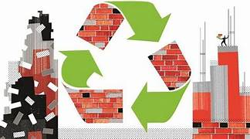
4. Cost-effective practices improve the overall economics of construction projects.
5. Recycling aligns with sustainability goals and showcases a commitment to responsible construction practices.
6. Recycling C&D waste lessens the negative environmental consequences associated with waste disposal.
18

Slide 19
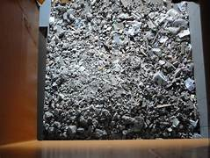
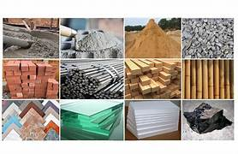
TRADITIONAL V/S RECYCLED
Traditional Methods
Recycled Materials
Traditional road construction primarily uses natural materials like gravel, sand, and aggregates obtained from quarries or mines.
The cost of natural materials can be relatively high, including expenses for extraction, transportation, and processing.
Extraction of natural materials can result in habitat disruption, soil erosion, and energy consumption.
The use of natural materials contributes to the depletion of finite resources.
Roads constructed with high-quality natural materials can have good durability if designed and maintained properly.
Recycled road construction involves using waste materials from construction and demolition sites, such as concrete, asphalt, bricks, and reclaimed aggregates.
Recycled materials can be more cost-effective as they reduce the need for raw material extraction and transportation.
Recycling C&D waste reduces the demand for new resources, conserving energy and reducing landfill waste.
It helps conserve natural resources by reusing materials that would otherwise be discarded.
When done correctly, recycled materials can offer similar durability to natural materials, but it depends on the quality of the recycled materials and construction techniques.
19

Slide 20
HOW?
Implementation : Preparing C&D Waste for Road Construction
Waste Collection: Gather construction and demolition waste materials, including concrete, bricks, and asphalt, from demolition sites.
Sorting and Segregation: Separate and classify the collected waste into different categories, such as concrete, brick, and asphalt rubble, ensuring the materials are free from contaminants.
Crushing and Processing: Crush and process the waste materials into suitable sizes and shapes for road construction, maintaining quality and uniformity.
Quality Control: Implement stringent quality control measures to ensure the recycled materials meet road construction standards and specifications.
Storage and Stockpiling: Store the processed C&D waste materials in designated areas for easy access and usage during road construction projects.
20

Slide 21
Solution - Replacement of aggregate in Subgrade and sub-base layers
Subgrade Preparation: Prepare the road subgrade by removing any unsuitable material and ensuring a stable foundation for the road.
Aggregate Replacement: Replace a portion of traditional aggregates in the subgrade layer with recycled C&D waste materials, maintaining the necessary engineering properties.
Compaction: Compact the subgrade thoroughly to ensure proper load-bearing capacity and stability.
Sub-base Construction: In the sub-base layer, partially replace traditional aggregates with recycled materials to reduce reliance on virgin resources.
Compaction and Gradation: Properly compact and control the gradation of the sub-base materials to meet road construction specifications.
21

Slide 22
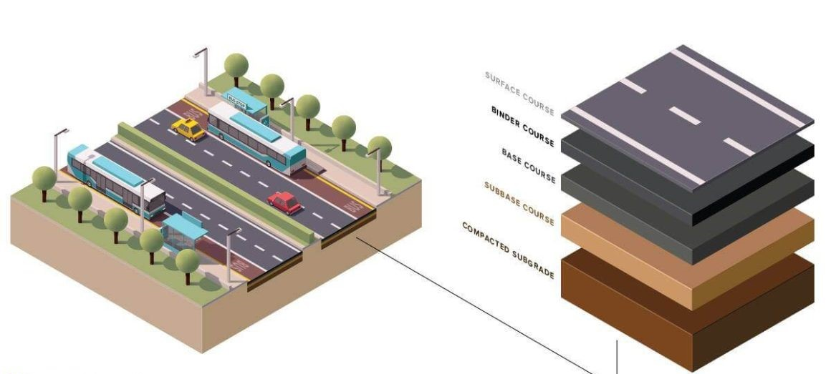
Cross section of Road Layers Wise
22

Slide 23
Asphalt Layers and Final Steps
Asphalt Mix Design: Incorporate recycled C&D waste materials into the asphalt mix design, ensuring compatibility and performance.
Mixing and Placement: Mix and place the asphalt mixture containing recycled aggregates as part of the sub-base and other layers in the road construction.
Quality Assurance: Monitor the quality of the asphalt mix and construction to ensure compliance with project specifications and standards.
Surface Treatment: Finish the road construction with the necessary surface treatments, such as asphalt overlay or seal coat, to provide a smooth driving surface.
Monitoring and Maintenance: Regularly monitor the road's performance and conduct maintenance as needed to ensure longevity and safe
23

Slide 24
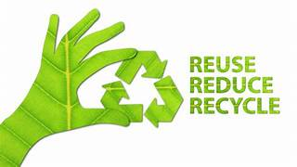
Conclusion
Our exploration of using recycled construction and demolition waste in road construction shows a positive way to be more eco-friendly, efficient, and save money. By recycling these materials in our road projects, we help the environment and cut costs, demonstrating our commitment to responsible construction and sustainability for the future.
24

Slide 25

“Waste Less, Build More”
25

